Slide 1
Rotor Blade Design
Week: 04
Date: 21.10.2025
Supervisor: Prof. Dr. rer.nat. Alois Schaffarczyk
Presented by – Kandarp Pathak
Team members : Jay Pandya, Harsh Panchal, Kandarp Pathak, Daniyal Sikander
Kandarp Pathak Matriculation Number 770533

Slide 2
List of contents
Overview
Output of the Code
Chord Length
Why it is important?
Explaintaion of Twist Angle
Kandarp Pathak Matriculation Number 770533

Slide 3
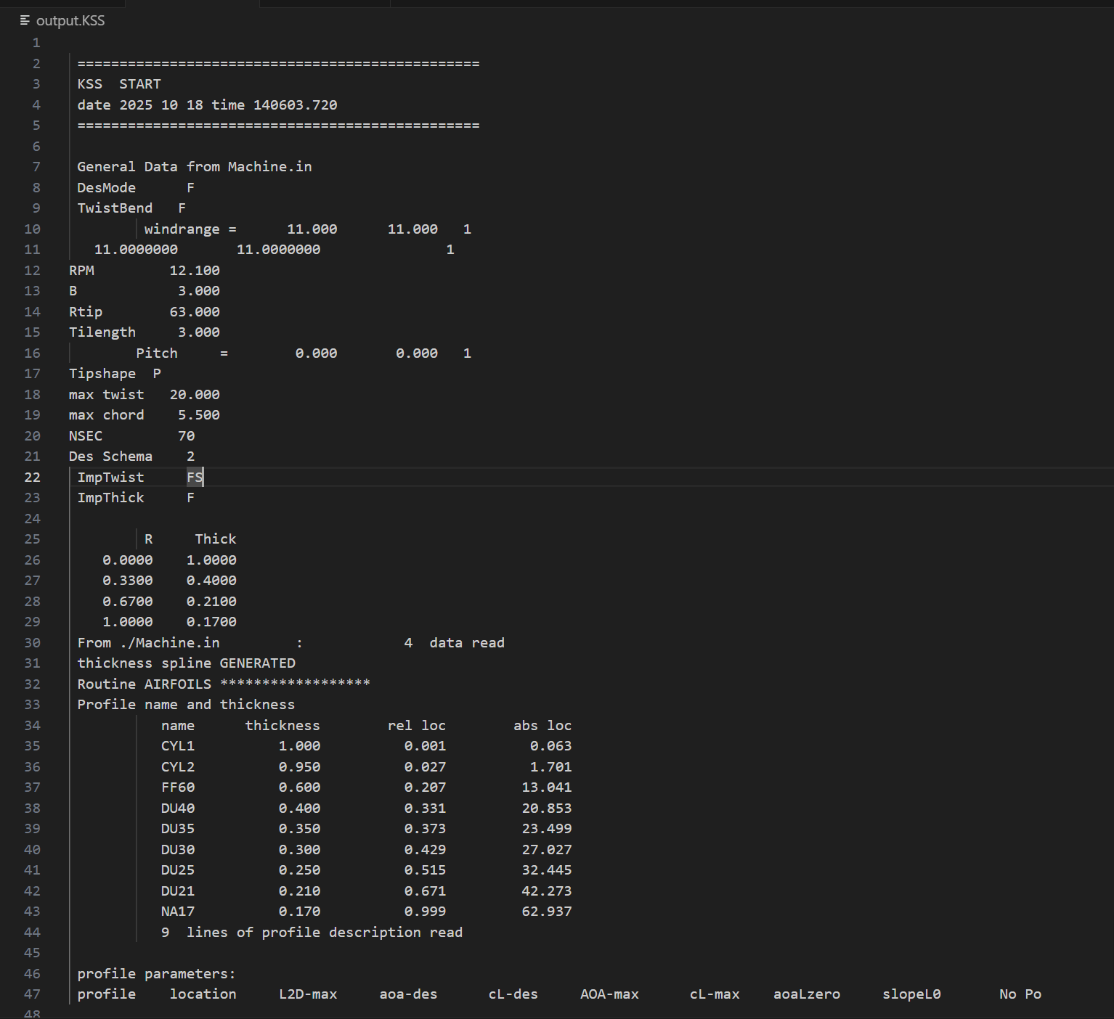
Output of the KSS Code
1. File Overview
KSS output file showing machine and aerodynamic data generated in Visual Studio Code.
2. Machine Parameters
Defines geometry and operation: RPM 12.1, Blade length 88, Tip radius 63, Pitch 0°.
Design mode and twist/bend settings configured for simulation.
3. Design Limits
Max twist = 20°, Max chord = 5.5, 70 blade sections used for detailed modeling.
4. Thickness & Airfoil Data
Thickness distribution decreases from 1.0 at root to 0.17 at tip.
9 airfoil profiles (e.g., CYL, DU, NA) define aerodynamic shape along the blade.
5. Purpose
File supports aerodynamic and structural blade design, ready for simulation or optimization processes.
Kandarp Pathak (770533)

Slide 4

Chord Length
Chord length (c):
The linear distance from the front (leading edge) to the back (trailing edge) of the airfoil. It determines how wide the blade section is at that point.
Chord length is largest near the root (to handle structural loads) and tapers toward the tip (for aerodynamic efficiency).
Function Of Chord Length:-
Affects lift, drag, and torque generation.
Larger chord → more lift but higher drag.
Smaller chord → less drag, better tip performance.
Kandarp Pathak (770533)

Slide 5
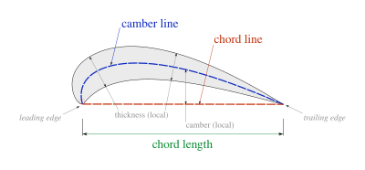
Why it is important?
Chord length is important because it determines how much lift and drag each section of the wind turbine blade produces.
A larger chord near the root provides structural strength and higher lift, while a smaller chord near the tip reduces drag and improves efficiency.
It directly affects the blade’s aerodynamic performance and power output. Proper chord distribution ensures optimal energy capture and balanced loading on the blade.
Figure Reference 1
Kandarp Pathak (770533)

Slide 6
Twist Angle
The twist angle is important because it aligns each section of the blade with the local wind direction, ensuring an optimal angle of attack along the entire span.
It helps maintain efficient lift generation from root to tip.
Without twist, outer sections could stall or produce negative lift.
Proper twist distribution increases overall turbine efficiency and smooths the load on the blade.
Kandarp Pathak (770533)

Slide 7
Next Week’s Work
To Determine exact numerical values for Chord Length and Twist angles for the 5 MW wind turbine.
Put the all values in code and determine the precise values.
Gather necessary aerodynamic and structural data for calculations.
We will discuss with the professor Schaffarczyk regarding next steps.
Kandarp Pathak (770533)

Slide 8
Bibliography
https://th.bing.com/th/id/R.846a70a37dbd456b5dc42682d0297d87?rik=xND8O9fBmvwqQw&pid=ImgRaw&r=0
Lecture notes of Prof. Dr. rer.nat. Alois Schaffarczyk.
https://github.com/Schaffarczyk/KSS-Blade
Kandarp Pathak (770533)

